Slide 1


Sales prediction on D2C ZALO
STEM INTERNSHIP PROGRAM 2023
Final presentation
24 | July | 2023

Slide 2







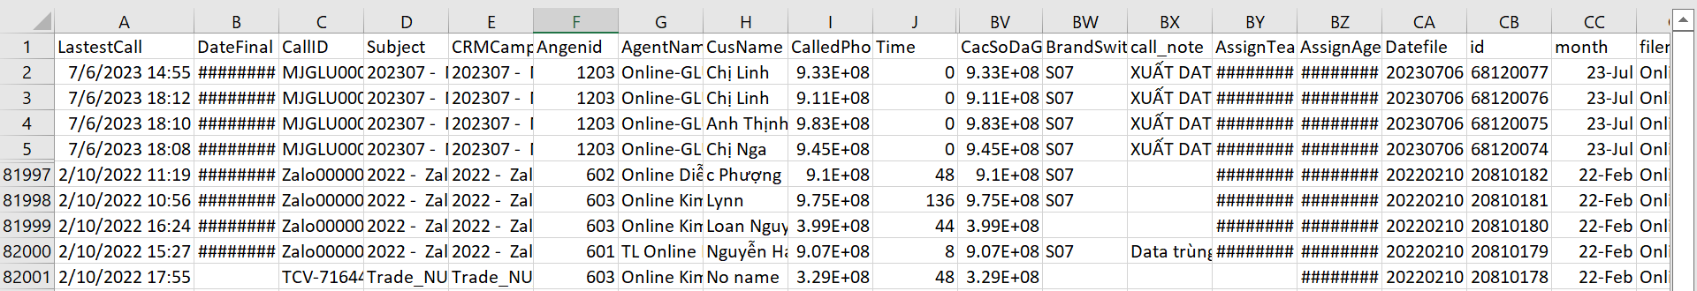
Professional work
Situation & task
Situation
Our CRM Team want to have a hint about the last quarter of 2023 sales of 5 milk brands sold via Zalo D2C make adjustments to increase sales.
Task
Data of all orders on Zalo D2C from Feb 2022 to July 2023
The largest dataset we have ever seen (82001 rows x 84 columns)

Slide 3
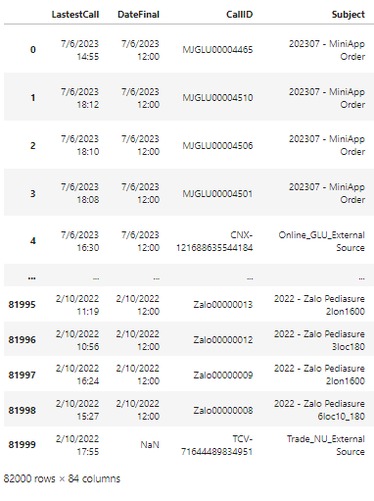
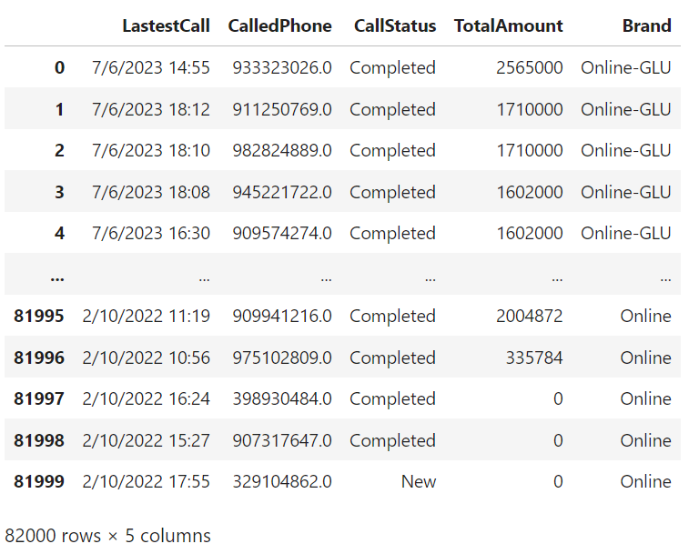
1. Data Pre-processing
Action
84 columns to 5 columns

Slide 4
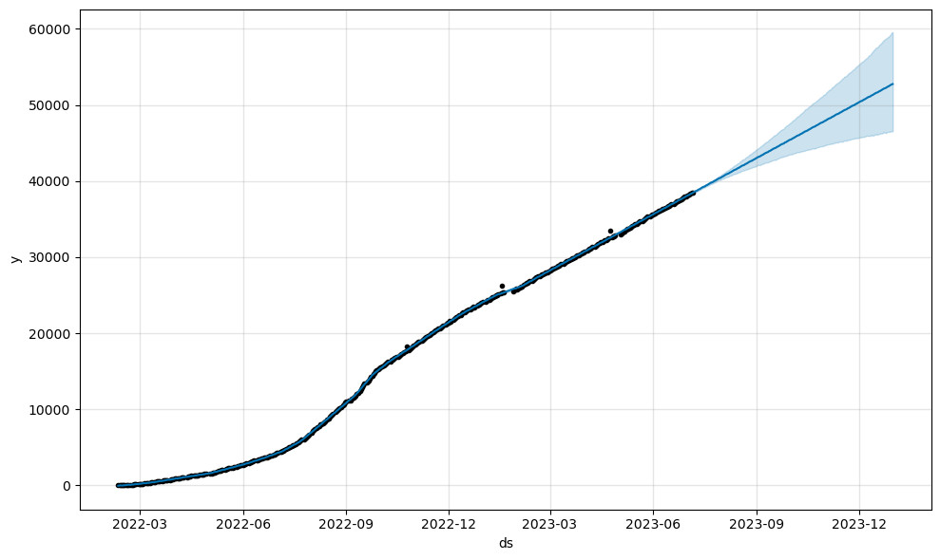
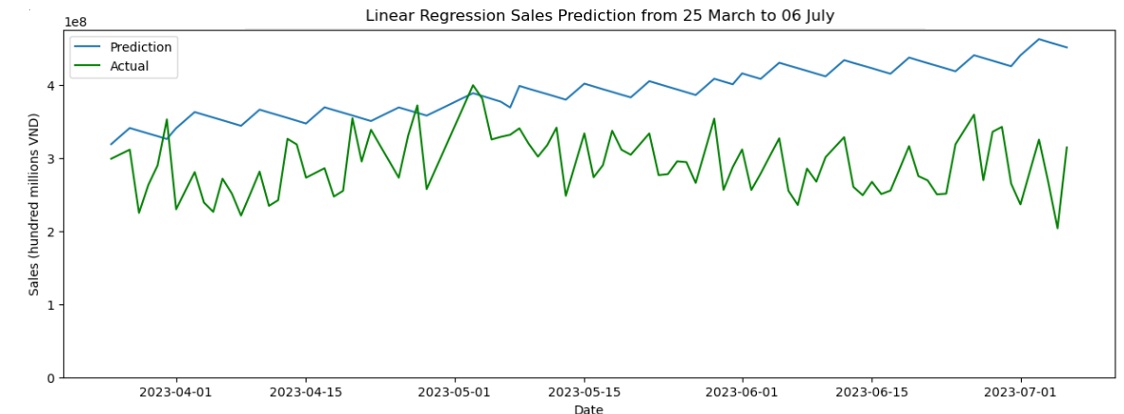
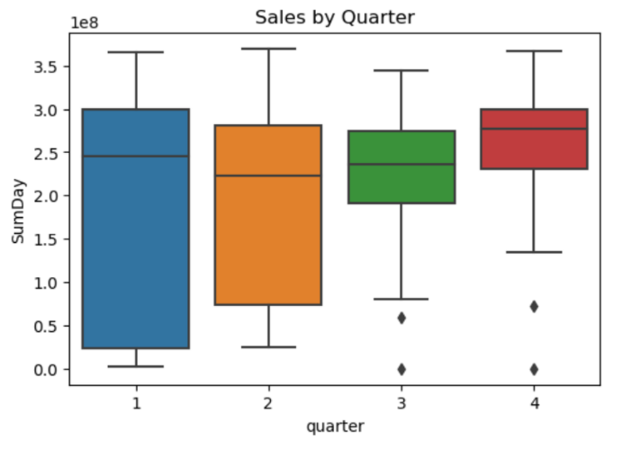
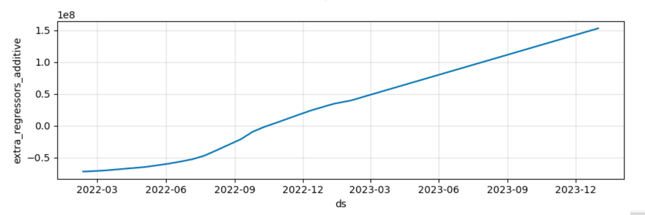
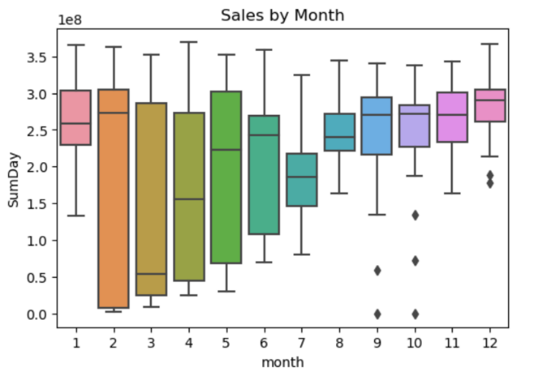
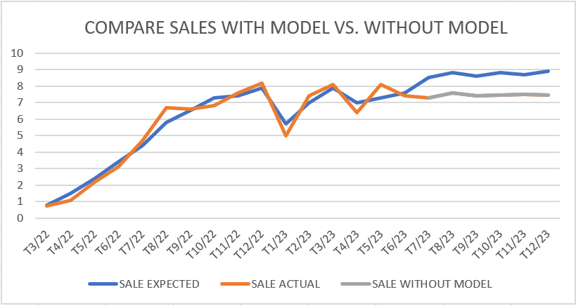
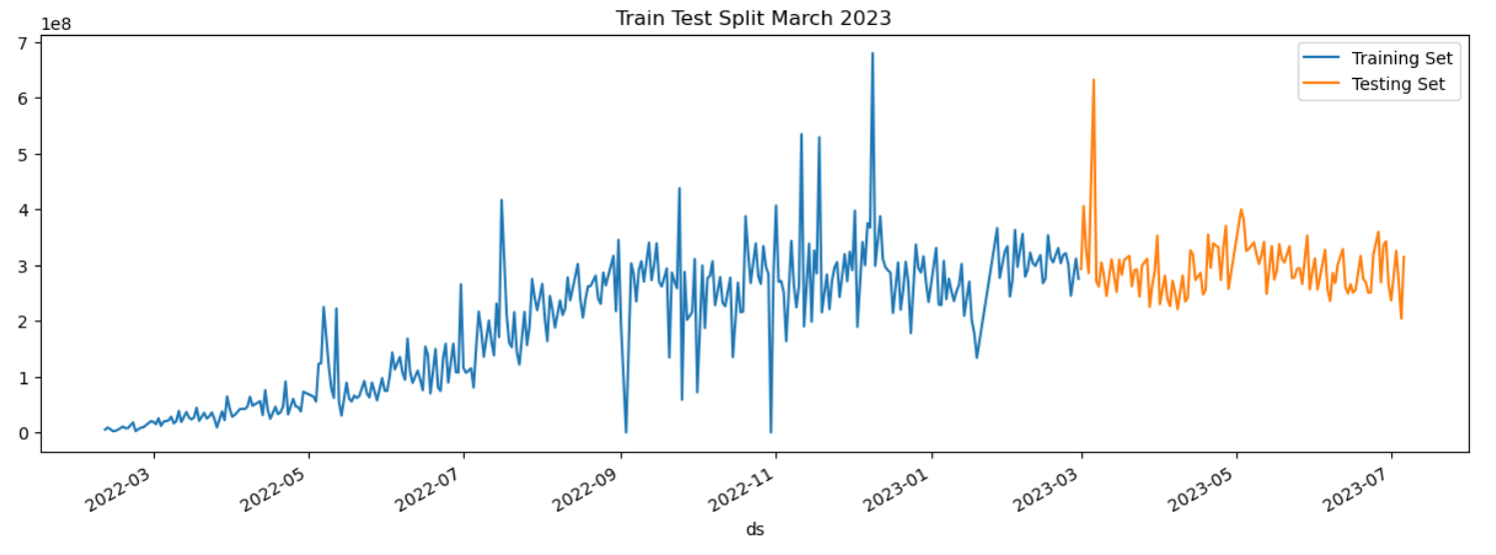
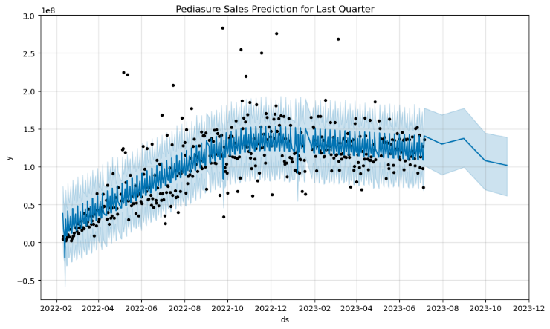
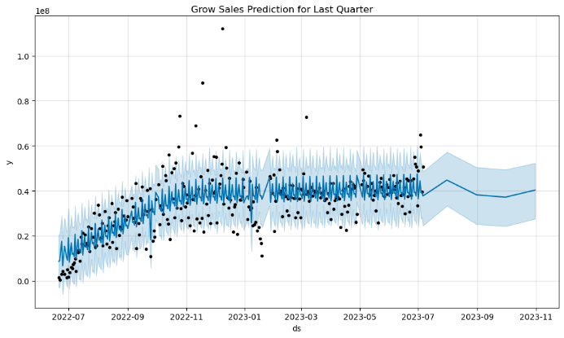
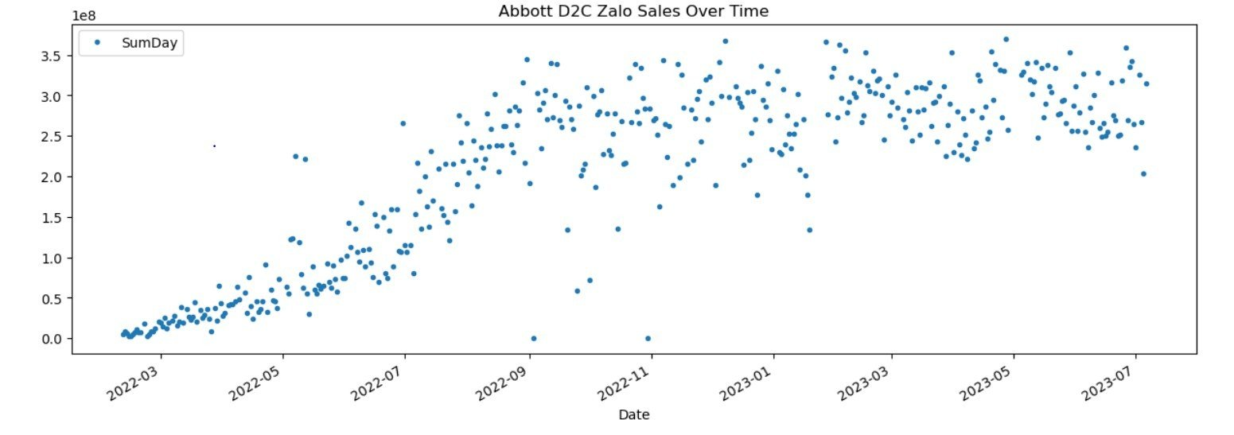
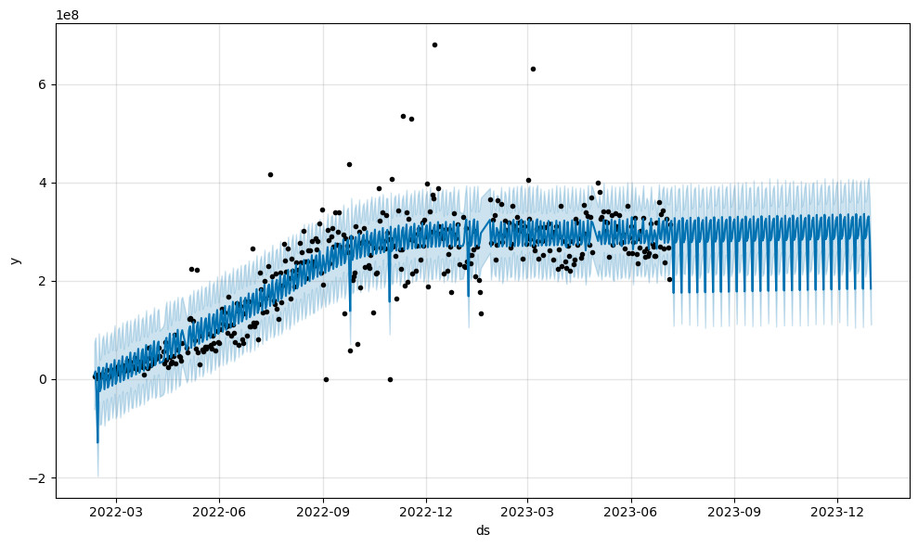
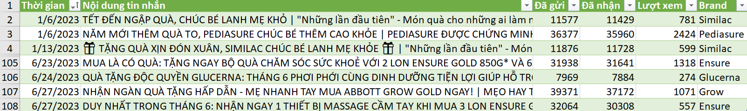
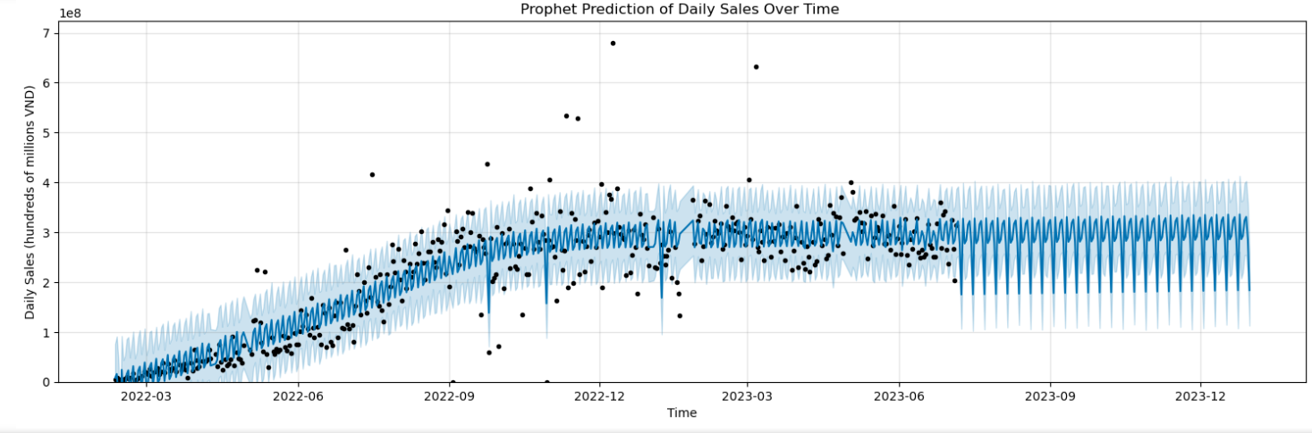
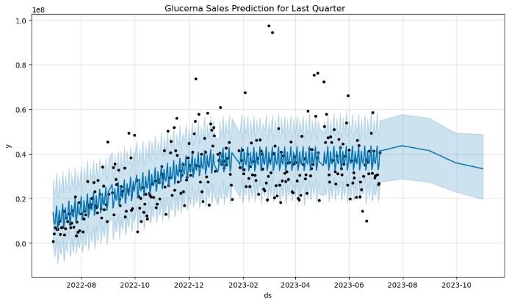
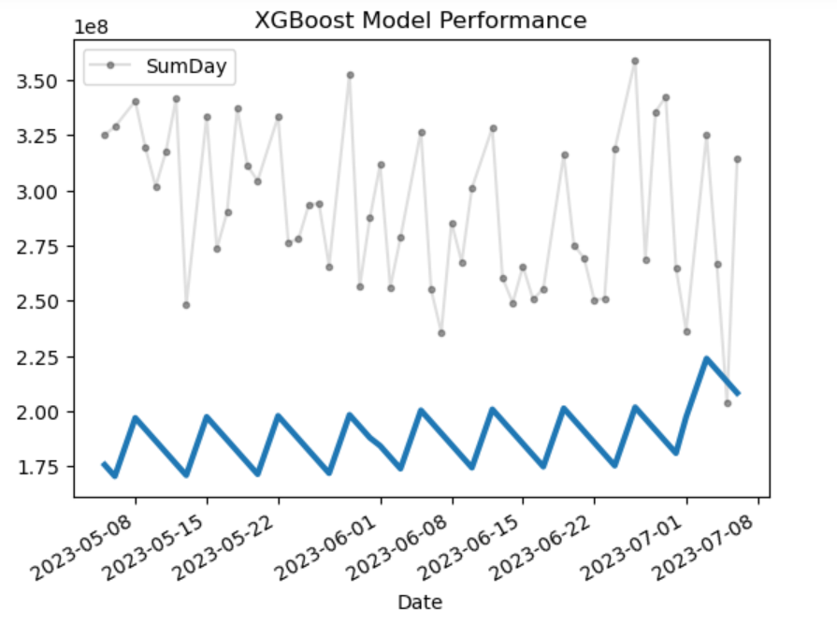
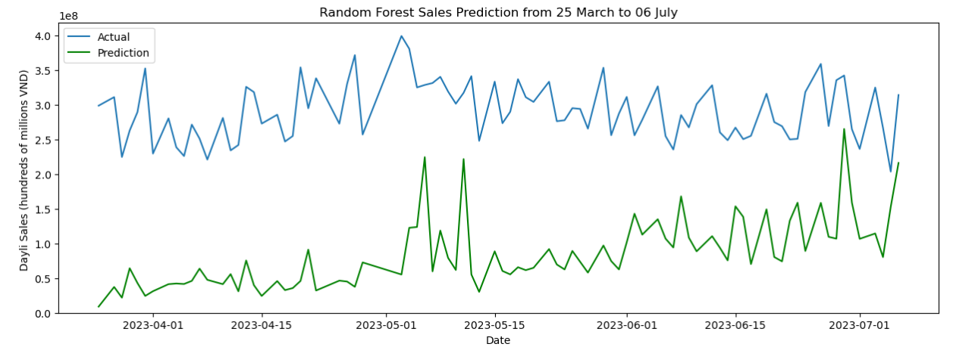
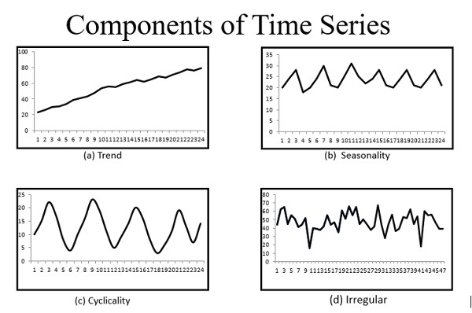
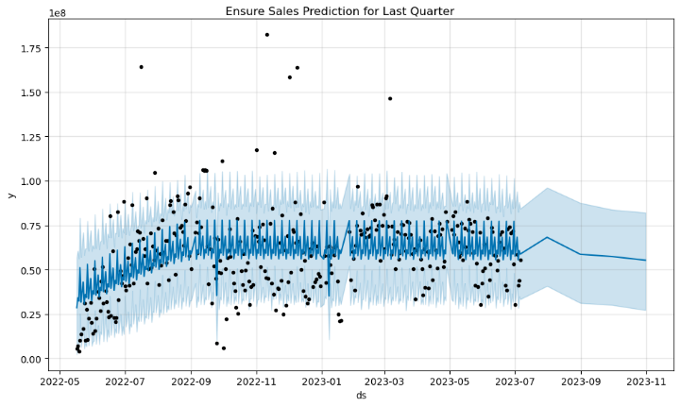
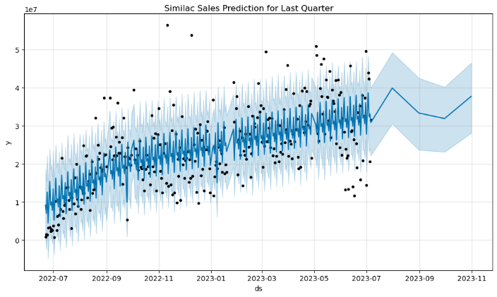
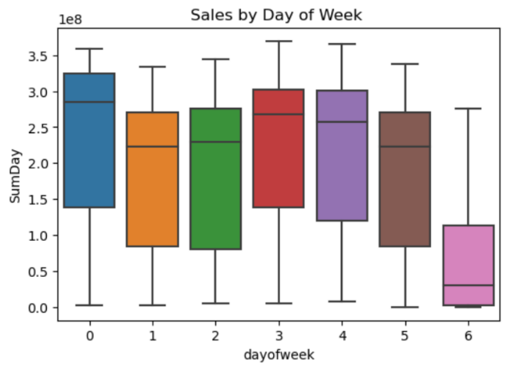
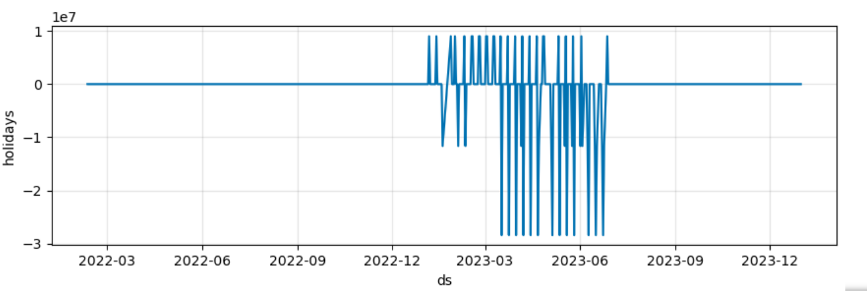
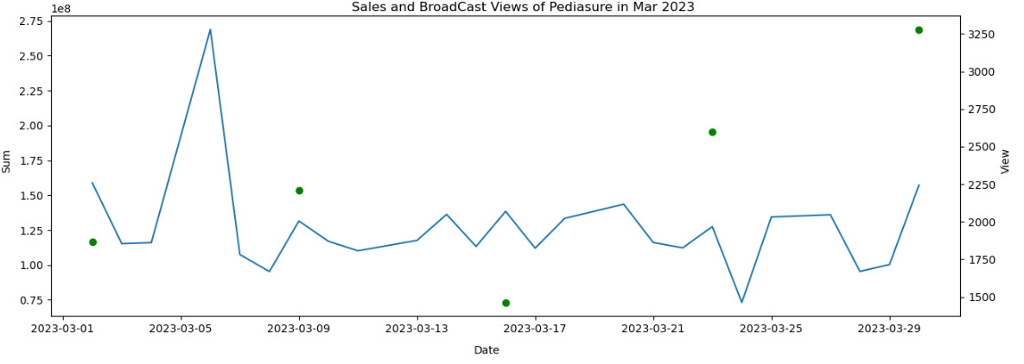
1. Data Pre-processing
Action
Action
6. Result
2. More data
3. Feature Creation
4. EDA (Exploratory Data Analysis)
5. Models
Because the sales depends on a lot of variables, our manager provided us with Data about Broad Casts data.
This is the events sent to customers as special events (“holidays”).
- We have tried several models, and some of them are failed: Linear Regression, Random Forest, XGBoost.
84 columns to 5 columns
Visualize Result
Create a new variable called “Customer Retention Power” based on number of customer have bought
Customer 1: buy 1-4 times
Customer 2: buy 4-15 times
Customer 3: buy >15 times
Welcome to PROPHET !!!
From 01 Mar to 06 July, model forecast 33.8 billions VND of sales.
Actual sales in that time: 31,4 billions VND
Revenue difference of 22.8 millions VND per day
Confidence: 90.4%
Model predict sales of 2023 reached 95,2 billions VND.
Customer Retention Power = Customer1 * 1 + Customer2 * 2 + Customer3 * 15
* SumDay – Sum of sales in a day
* SumDay – Sum of sales in a day
* 0 – Monday; 6 - Sunday

Slide 5
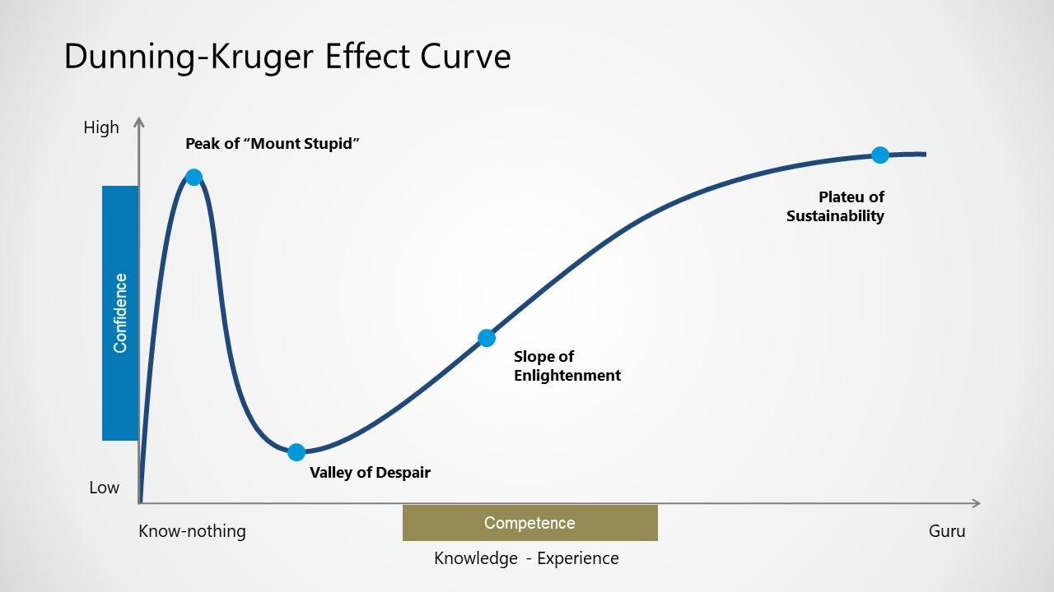
Ending
Internship journey in a nutshell

Slide 7
3. Feature Creation
Action
Create a new variable called “Customer Retention Power” based on number of customer have bought
Customer 1: buy 1-4 times
Customer 2: buy 4-15 times
Customer 3: buy >15 times
Customer Retention Power = Customer1 * 1 + Customer2 * 2 + Customer3 * 15

Slide 8
4. EDA (Exploratory Data Analysis)
Action
* SumDay – Sum of sales in a day

Slide 9
4. EDA (Exploratory Data Analysis)
Action
* 0 – Monday; 6 - Sunday

Slide 10
5. Models
Action
- We have tried several models, and some of them are failed: Linear Regression, Random Forest, XGBoost.
* SumDay – Sum of sales in a day

Slide 11
Action
Welcome to PROPHET !!!

Slide 12
5. Models
Action

Slide 13
Action

Slide 14
Action
6. Result

Slide 15
Action
6. Result
Visualize Result
From 01 Mar to 06 July, model forecast 33.8 billions VND of sales.
Actual sales in that time: 31,4 billions VND
Revenue difference of 22.8 millions VND per day
Confidence: 90.4%
Model predict sales of 2023 reached 95,2 billions VND.

Slide 16
Action
6. Result

Slide 17
Ending
Internship journey in a nutshell

